Slide 1
Women’s Clothing Review Analysis with Extraction-Based using Clustering and Topic Modelling Techniques
What’s the name, again?
Nathaniel Takeshi Inatori Lauw (its5002211175)
Nyoman Wikananda Santana (its5002201043)
Muhammad Jalu Herlambang (its5002201132)

Slide 2
Background
Understanding customer reviews may enhance business marketing strategies for better customer acquisition and retention.
Product reviews may contain satisfactions or critics that helps boost sales performance
Notes:
Customer segmentation involves categorizing customers into distinct groups based on various criteria. By understanding different customer segments, business can tailor their marketing efforts more effectively. Targeted marketing strategies can lead to better customer acquisition and retention.
Many customers read online reviews from other buyers before making a purchase decision. Positive reviews not only boost sales but also build trust in a brand or product. Negative reviews highlights areas for improvement and acts as constructive criticism for business owners.

Slide 3
Objective
Generate clusters of different customer and extract review information with topic modeling technique
Analyzing different clustering and topic modeling technique performance
Notes:
Make a customer segmentation with clustering and get topics for each cluster to understanding

Slide 4
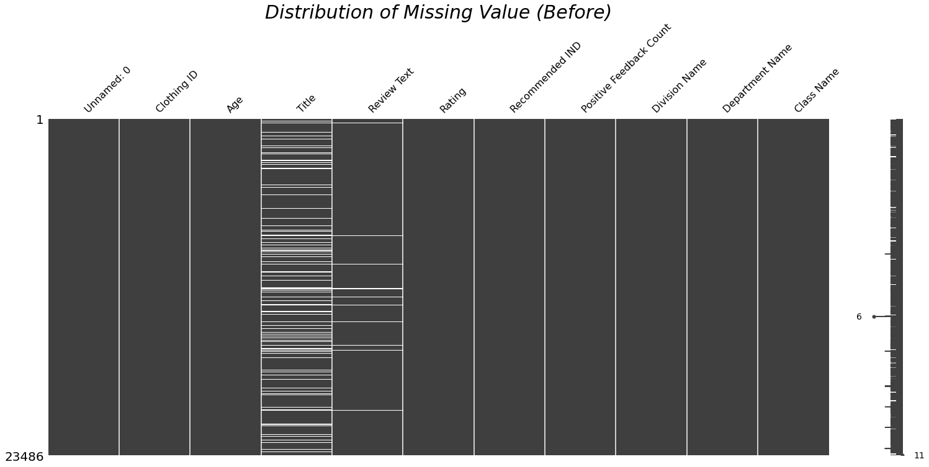
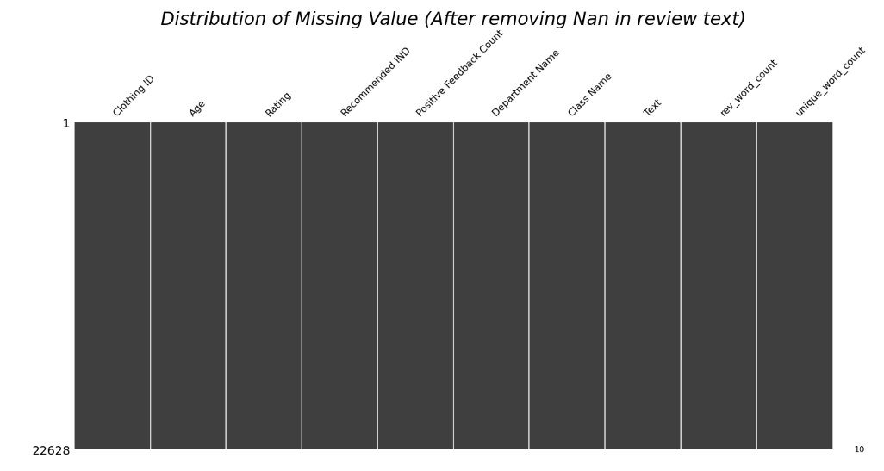
Exploratory Data Analysis
Notes:
Delete NaN data in 'Review Text'
Combining 'Title' and 'Review text' ----> 'Text' colomn
Make new 'word count' and 'unique word count' colomn to count word in Text colomn, and

Slide 5
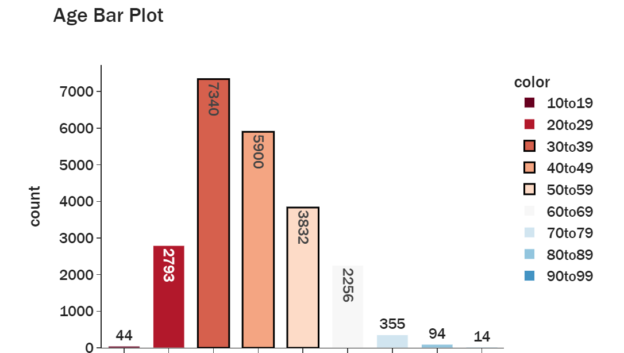
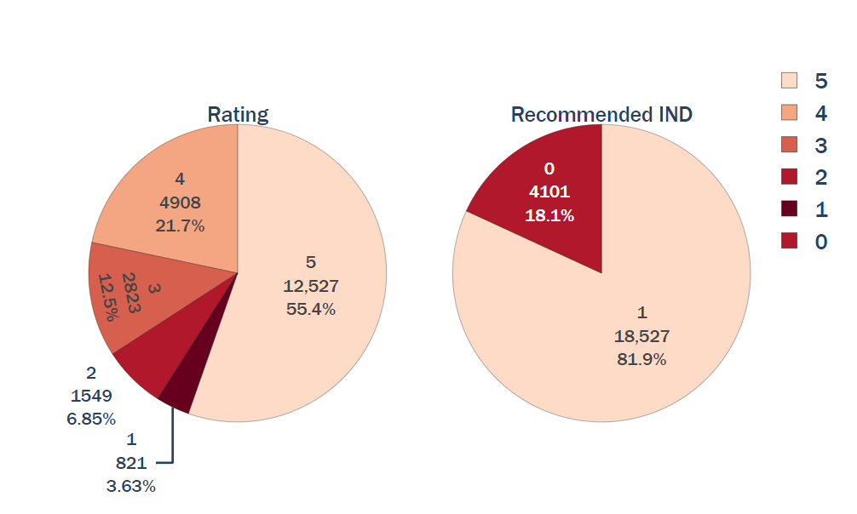
Exploratory Data Analysis (cont.)
Notes:
Imbalance rating data
Count of customer that give rating 1-3 but recommend: 1279
Count of customer that give rating 4-5 but not recommend: 187

Slide 6
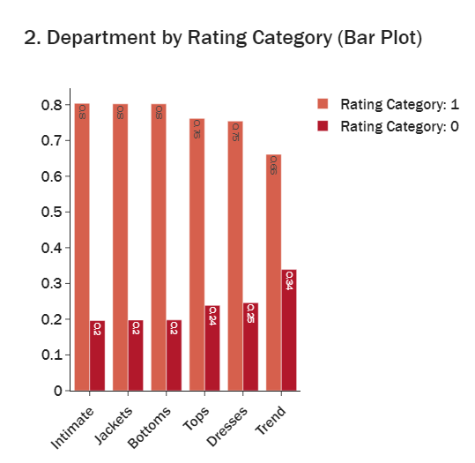
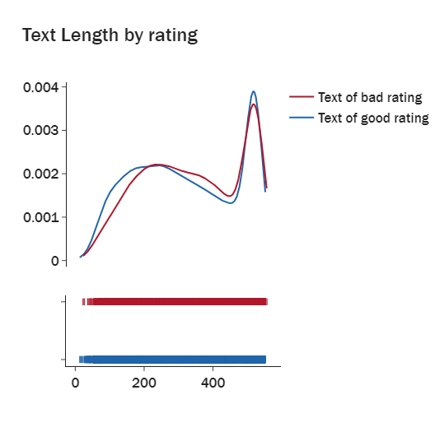
Exploratory Data Analysis (cont.)
Distribution
Distribution
Text length
Department Name
Notes:
Mostly good rating have more length te
Text of good rating are dsitributed along with higher length relatively.
Trend departement have more bad rating (1-3)
X-axis (horizontal axis): This represents the "Text_Length" values from your DataFrame. The text lengths are the lengths of the comments, and the X-axis will display the range of these lengths for both recommended and unrecommended comments.
Y-axis (vertical axis): This represents the probability density of the text lengths. The Y-axis shows how the text lengths are distributed within the dataset, indicating the relative likelihood of different text lengths occurring in the recommended and unrecommended comments.
Since show_hist=False was specified, the plot will xt (4-5) display smoothed curves (kernel density estimation) instead of histograms, giving a continuous estimate of the distribution of text lengths.

Slide 7
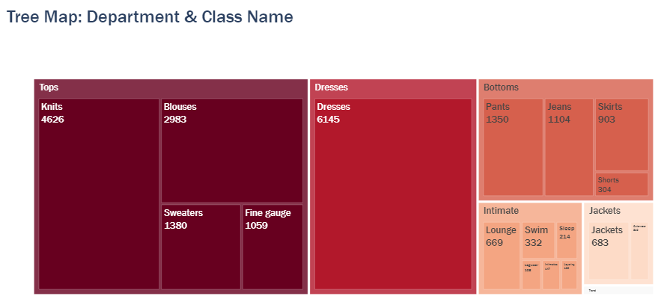
Exploratory Data Analysis (cont.)
Notes:
'Trend': 118 'class_name' 'trends_data':['Trend']

Slide 8
Feature Engineering
Add Sentiment rate (VaderSentiment)
Bucketing Clothing ID's with appearance less than 200
Text Preprocessing
Lower casing
Stopword and punct removal
POS tagging (Noun and Adjective)
Add business stopword exclude
Notes:
Vader works by assigning a polarity score to a piece of text, indicating whether the text is positive, negative, or neutral. It rates each word based on its own lexicon whether it is positive or negative, and then summing them up

Slide 9
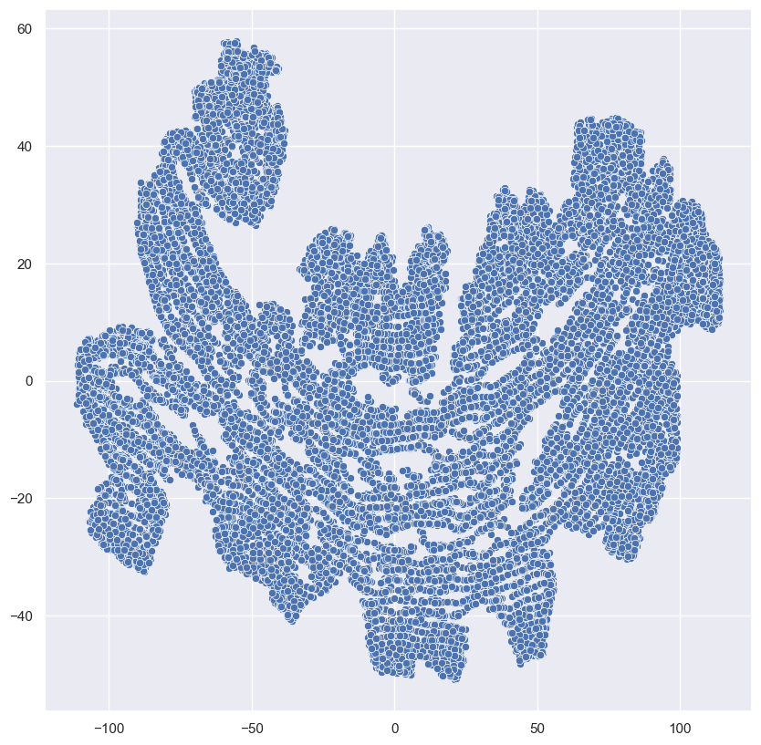
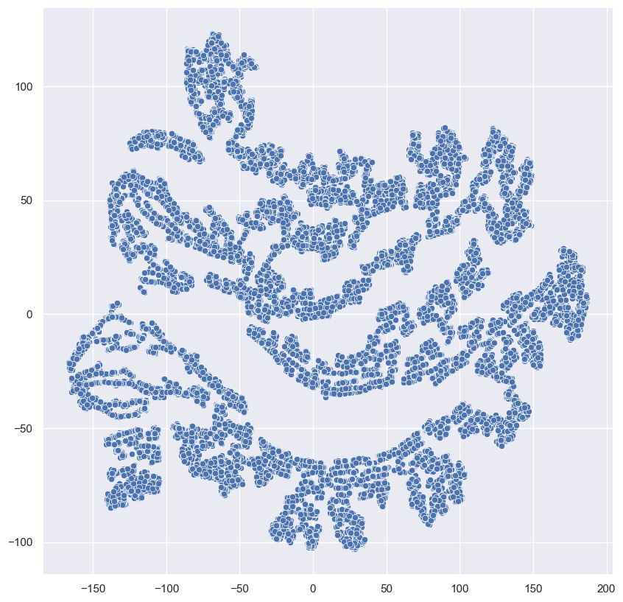
PCA + t-SNE plot
Perplexity = 171
Perplexity = 50

Slide 10
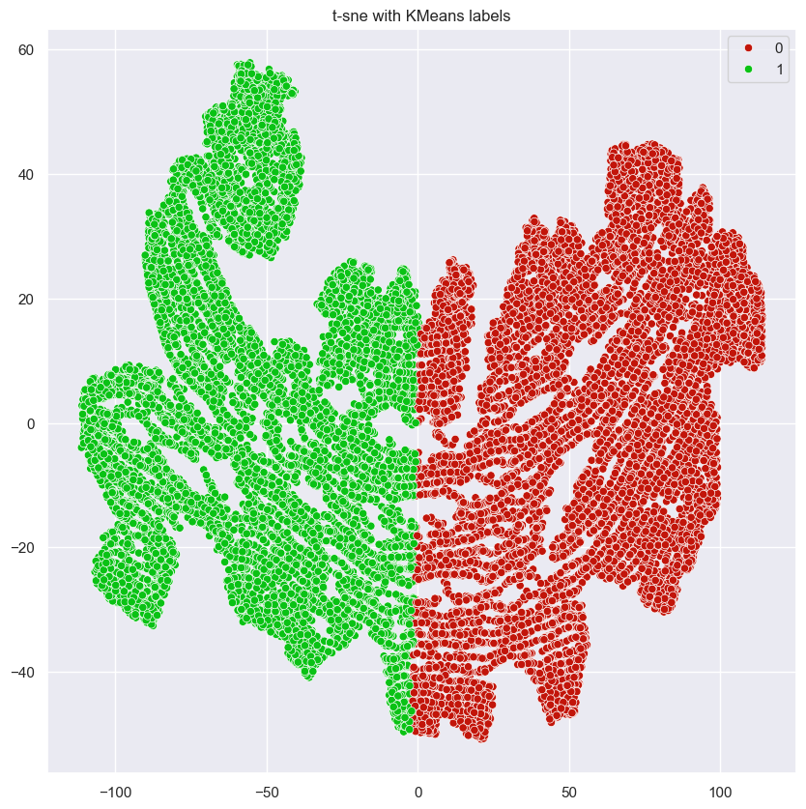
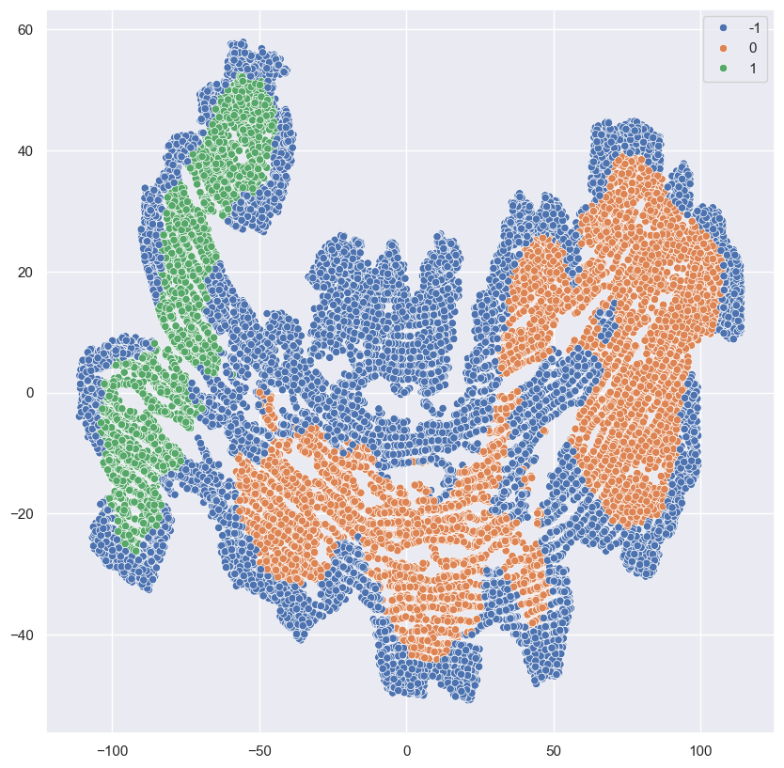
K-Means vs HDBSCAN

Slide 11
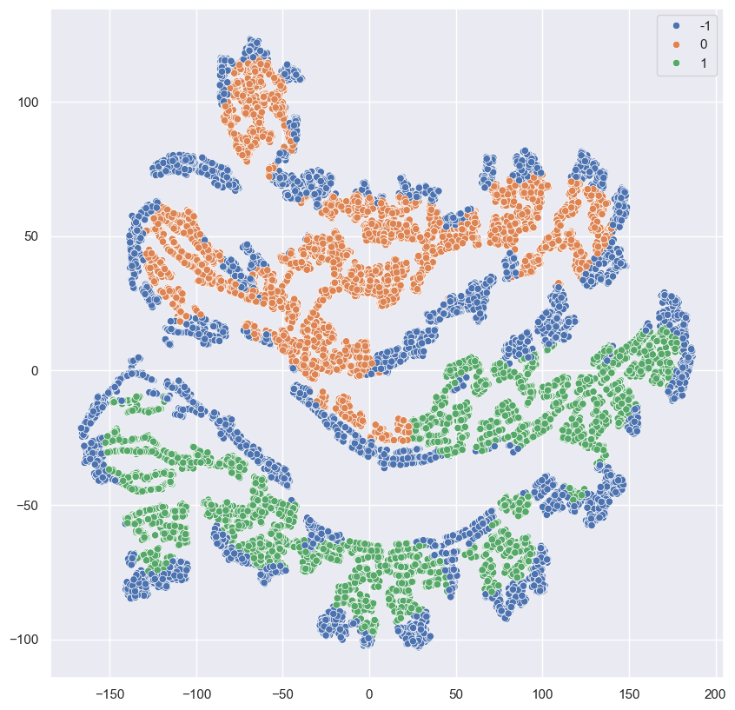
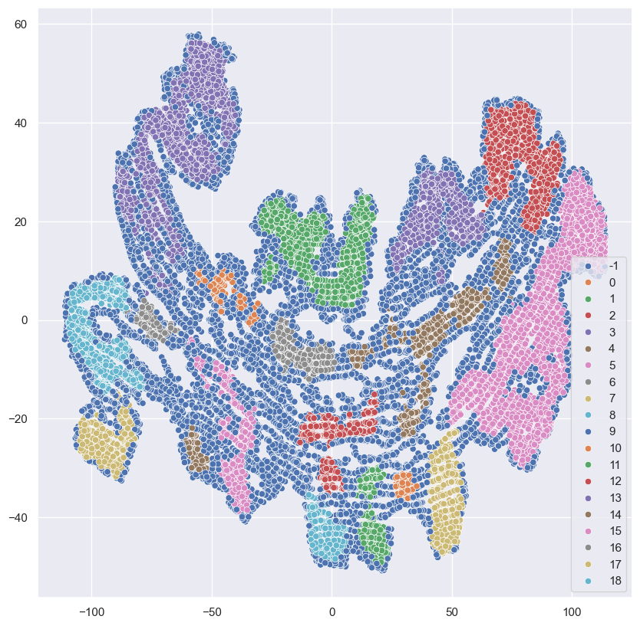
HDBSCAN Experiments

Slide 12
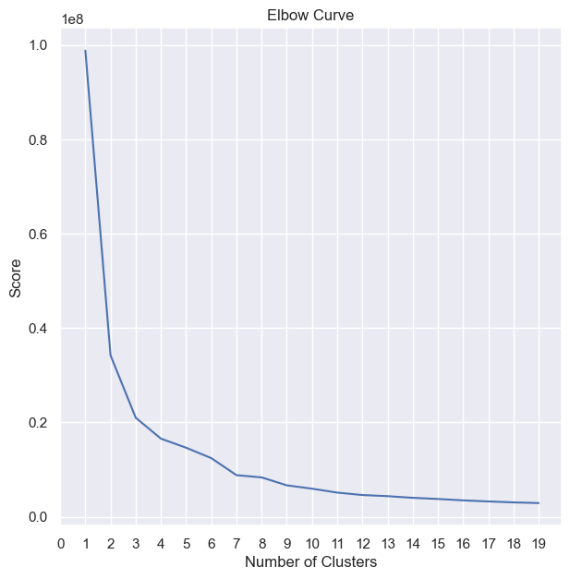
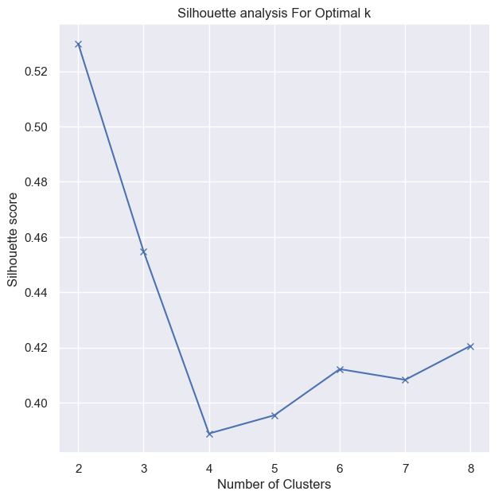
Determining K-Means Optimal Clusters

Slide 13
Clustering using K-Means vs HDBSCAN
t-sne with HDBScan labels
Silhouette Score | K-means | HDBSCAN
 | 0.530 | -0.006

Slide 14
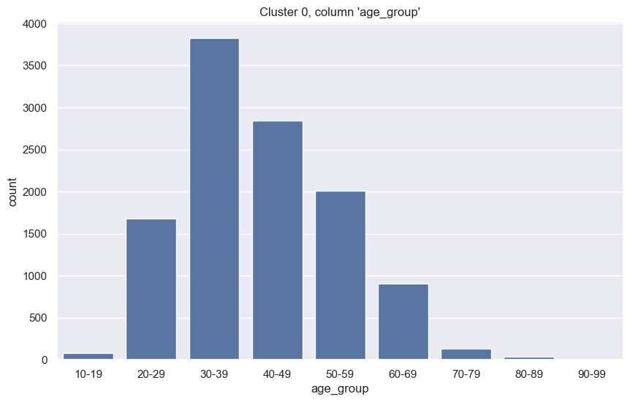
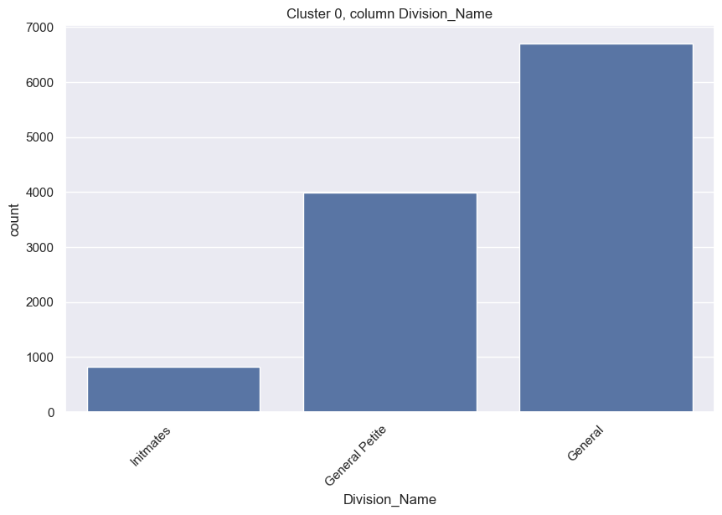
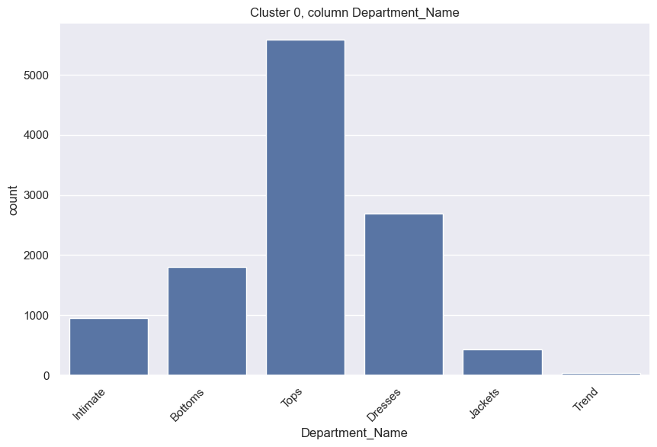
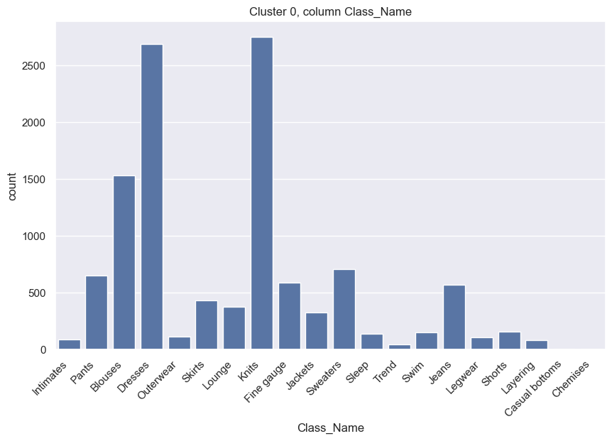
Cluster Representation
Cluster 0

Slide 15
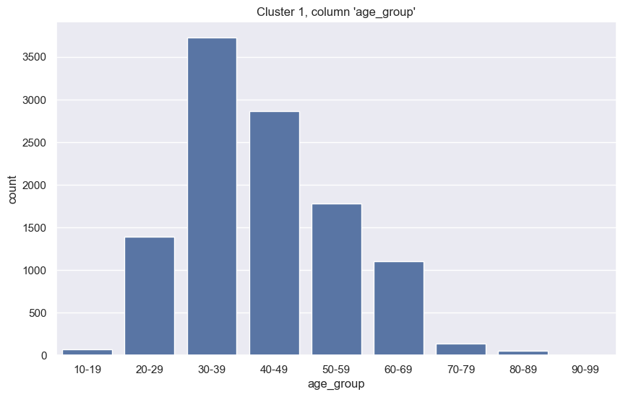
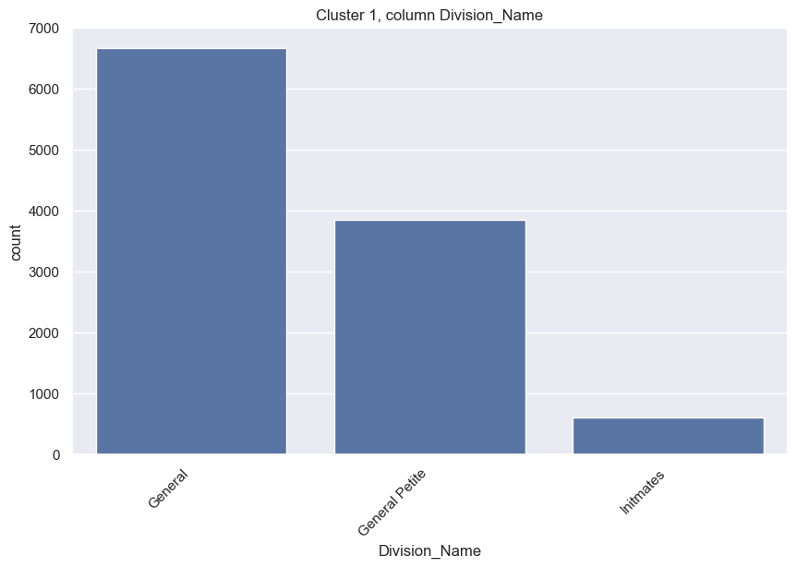
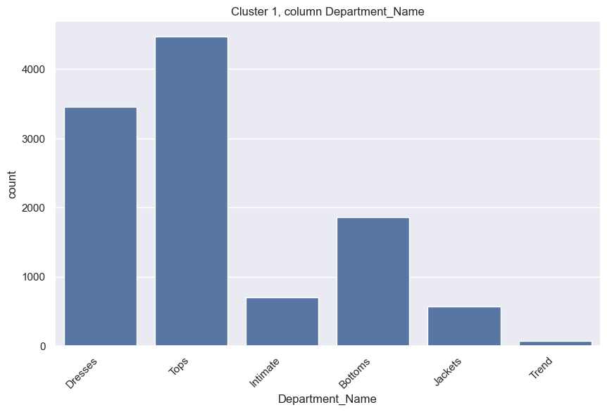
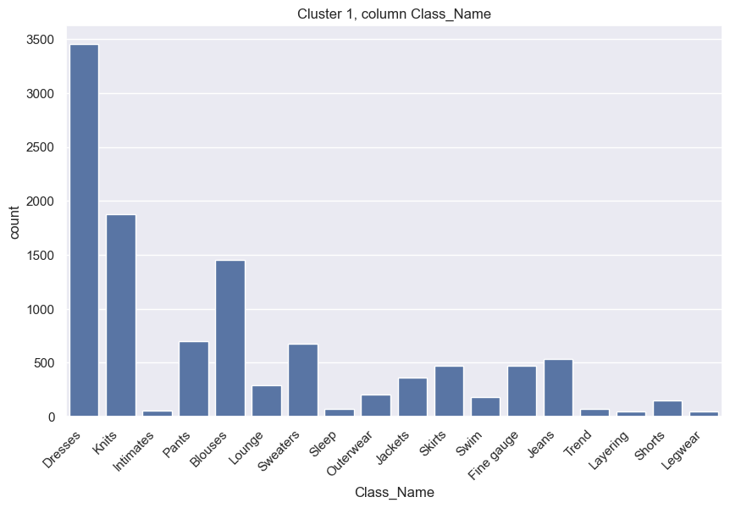
Cluster Representation (cont.)
Cluster 1

Slide 16
Topic Modeling
Latent Dirichlet Allocation (LDA)
Assume all the documents built by several topics
Generate the topic by mixture of words by calculating the distribution value
BERT (BERTopic)
Utilize BERT LLM
Generate the number of topics exists for all documents
Generate the topic by mixture of words

Slide 17
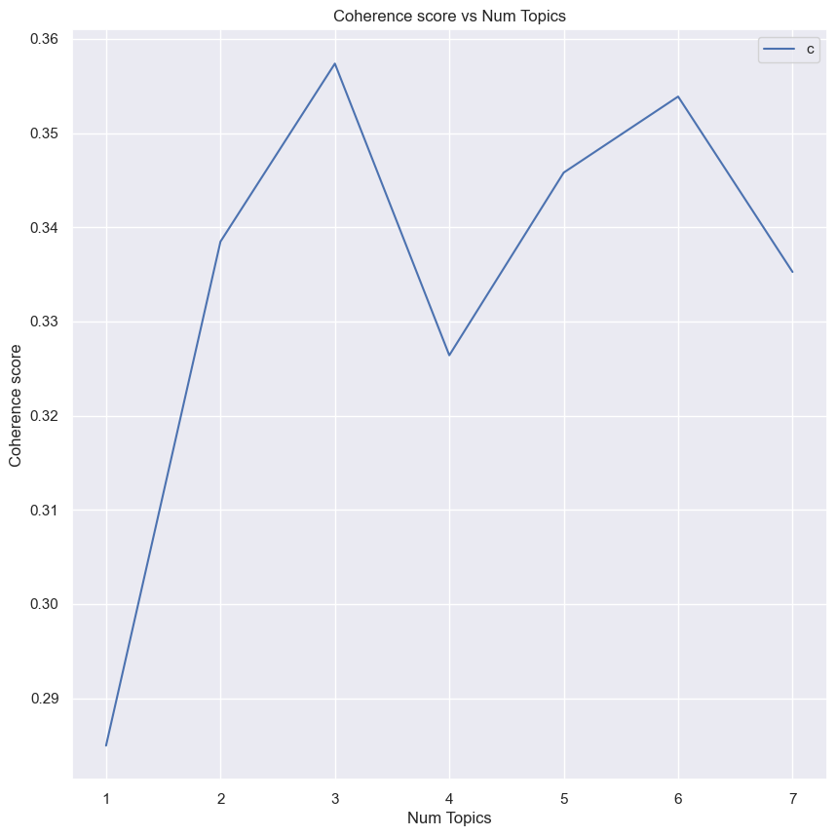
LDA Optimal Number of Topics
Assuming optimal number of topics for all data will be applied when extracting topic for each cluster
Coherence score maximized during 3 topics
Optimal number of topics is 3

Slide 18
LDA vs BERT
K-means Clustering
Coherence Score | Cluster-# | LDA | BERT
 | Cluster 0 | 0.251 | 0.787
 | Cluster 1 | 0.235 | 0.801
Average Coherence Score |  | 0.243 | 0.794
HDBSCAN Clustering
Coherence Score | Cluster-# | LDA | BERT
 | Cluster 0 | 0.273 | 0.832
 | Cluster 1 | 0.252 | 0.719
Average Coherence Score |  | 0.263 | 0.776

Slide 19
Topic Extracted
Model: K-means + BERT
Cluster 0:
['dress', 'top', 'great', 'size', 'fit', 'love', 'fabric', 'im', 'small', 'material’]
['great', 'size', 'top', 'dress', 'fit', 'love', 'comfortable', 'soft', 'small', 'shirt’]
['daughter', 'gift', 'loves', 'size', 'top', 'beautiful', 'cute', 'birthday', 'petite', 'im’]
['photos', 'measurements', 'reference', 'medium', 'size', 'top', 'person', 'online', 'much', 'mauve']
Regarding the fit, probably some issue with the size (small), the material
Regarding the fit, probably some issue with the size (small), the material is comfortable
Gift for daughter, beautiful and cute design, gift for birthday
Customer may insist availability of photos and measurements. Probably some problem between online reference and actual product. Concern about specific color (mauve)

Slide 20
Topic Extracted (cont.)
Model: K-means + BERT
Cluster 1:
['size', 'top', 'fit', 'fabric', 'im', 'small', 'dress', 'great', 'little', 'soft’]
['dress', 'size', 'fit', 'top', 'im', 'great', 'small', 'fabric', 'little', 'love’]
['joggers', 'jogger', 'fit', 'perfect', 'pair', 'comfy', 'little', 'pants', 'comfortable', 'small’]
['green', 'store', 'saw', 'try', 'great', 'love', 'little', 'online', 'fall', 'catalog']
Regarding the fit, probably some issue with the size (small), the material
Regarding the fit, probably some issue with the size (small), the material is comfortable
Jogger outfit with comfortable material, potential problem with size (small)
Regarding color (green), the great online catalogue which make the customer try the cloth

Slide 21
Conclusion
LDA and BERT successfully extract different topics to generalize the review topics
In clustering, K-Means excel in terms of Silhouette Score metric (0.5301289) compared to HDBSCAN
Best result obtain using K-Means + BERT in terms of average coherence score (0.794)
Unfortunately, there is only minimal negative topics successfully extracted due to imbalance data

Slide 22
Some Insights for the Business Owner
Most of customer are around 30-39 and 40-49. Advertising can be more directed towards those group of ages
Super popular products are blouses, dresses, and fine gauge. Advertise and innovate in those products more
Make clothing size information clearer
Available design is good, keep it. Or innovate using the similar design mood
Utilize online catalogue, make it pretty
Make Birthday Gift Event (Package or Discounts) or children cloth packages or discounts

Slide 23
QnA
Questions are like free real estates…

